Slide 1
70-432 – Optimizing Performance
Paweł Hofman
PLSSUG Wrocław
7 grudnia 2009

Slide 2
Agenda
Database Engine Tuning Advisor
Resource Governor

Slide 3
Optimization
From the administrator point of view it is:
adding an index
dropping an index
partitioning table
storage-aligning tables

Slide 4
Database Engine Tuning Advisor
Is provided as:
command line executable ‘dta.exe’
UI stand-alone application ‘dtashell.exe’
Options:
time limitations
online/offline changes implementation
indexes
partitioning
update or retain existing database structure (add or remove)

Slide 5
Database Engine Tuning Advisor
Source workloads (obciążenie) from:
T-SQL script
SQL table
SQL Profiler trace file
SQL Profiler trace table
SQL Profiler trace analysis is based on:
RPC:Starting
RPC:Completed
SQL:Batch Starting
SQL:Batch Completed

Slide 6
Database Engine Tuning Advisor
Output recommendations:
T-SQL scripts (for db schema changes)
estimated improvement (percentage)
statistics and reports
query frequency within workload
query cost
also about indexes

Slide 7
Database Engine Tuning Advisor
WARNING
Not recommended to enable in production environment as the numbers of statistics and query cost calculations used for workload analysis will have an impact on overall performance.
EXAM TIP
It is good to know impact of all options on DTA’s output recommendations.

Slide 8
DTA Demo
Launching DTA
Creation of workload
Database schema manipulations
Reports

Slide 9
Resource Governor
Optimization of server resources utilization
Problems with resources:
queries killing the server (“runaway queries”)
can’t estimate the time for parallel queries
can’t protect business critical operations
Where:
lots of applications using database
SQL hosting providers

Slide 10
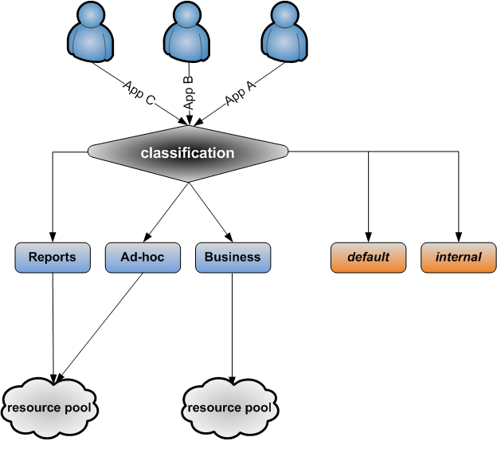
Resource Governor
Works with components:
resource pool (min/max percentage for memory & CPU)
workload groups
classification function

Slide 11
Resource Governor
Facts:
workload group can belong to only one resource pool
many workload groups might belong to the same pool
classification is made once during connection and can’t be changed without reconnection
classification function should be quick not to cause ‘connection timeout’
if non-existing group name is returned by classification function than ‘default’ is used
‘default’ and ‘internal’ groups work without any restrictions
‘internal’ group is used by Service Broker, checkpoint, lazywriter

Slide 12
Resource Governor
Limitations:
Database Engine ONLY (no limits are put on Analysis Services, Reporting Services, Integration Services)
only monitors single instance on the machine (more instances must use affinity option)
resources are limited only on connection basis, not based on types of queries
limits only
CPU
memory (Query Execution Memory, not caches)
no restrictions over I/O

Slide 13
Resource Governor
EXAM TIP
Remember that Resource Governor can control, only CPU and memory consumption, but only when particular connections are active.
Additional info:
SELECT * FROM sys.resource_governor_resource_pools
SELECT * FROM sys.resource_governor_workload_groups
SELECT * FROM sys.resource_governor_configuration

Slide 14
Resource Governor
CREATE WORKLOAD GROUP <group_name>
[ WITH
( [ IMPORTANCE = { LOW | MEDIUM | HIGH } ]
[ [ , ] REQUEST_MAX_MEMORY_GRANT_PERCENT = value ]
[ [ , ] REQUEST_MAX_CPU_TIME_SEC = value ]
[ [ , ] REQUEST_MEMORY_GRANT_TIMEOUT_SEC = value ]
[ [ , ] MAX_DOP = value ]
[ [ , ] GROUP_MAX_REQUESTS = value ] )
]
[ USING { <pool_name> | "default" } ]
[ ; ]

Slide 15
Resource Governor
ALTER RESOURCE GOVERNOR { DISABLE | RECONFIGURE }
|
WITH ( CLASSIFIER_FUNCTION = { <schema_name.function_name> | NULL } )
|
RESET STATISTICS
[ ; ]

Slide 16
RG Demo
Launching Resource Governor
Creation of resource pools
Creation of workload groups
Creation of classification function (UDF)
Monitoring via Performance Counters

Slide 17
70-432
Optimizing Performance
GAME OVER
Questions ?

